Slide 1

AI-Powered Smart Exhibition Management System with Agentic Event Assistant
SOA Project Review-1
29-08-2026
 | Under the Guidance of Dr.Neelima Gogineni Department of Computer Science and Engineering, KLH CSE Bowrampet Campus
Team Members G.V.S Hasini - 2420030735 G.Hemalatha - 2420030703

Slide 2

Outline of Project Work
Focus
Introduction
Literature Survey
Challenges
Research Objectives
Conclusion & Future Work
References
Publications Details

Slide 3
Problem Statement
Traditional exhibition and event management systems rely heavily on manual processes for visitor registration, stall management, scheduling, navigation, communication, and feedback collection. Visitors often struggle to find relevant stalls, events, and sessions, while organizers face difficulties in managing large numbers of attendees, coordinating exhibitors, monitoring event activities, and providing personalized assistance.
Therefore, there is a need for an AI-Powered Smart Exhibition Management System with an Agentic Event Assistant that can intelligently automate and coordinate exhibition-related activities. The system should use Artificial Intelligence and agentic capabilities to understand user requirements, provide personalized recommendations, answer queries, guide visitors, manage schedules, and assist organizers in real time.
The proposed system aims to create a smart, interactive, and efficient exhibition environment where an AI agent acts as a virtual event assistant, reducing manual workload for organizers while improving the overall experience for visitors and exhibitors.

Slide 4
Objectives
Automate Exhibition Management – Reduce manual work in visitor registration, stall management, scheduling, and feedback collection.
Develop an AI-Based Event Assistant – Provide instant and intelligent responses to visitors’ queries about the exhibition.
Provide Personalized Recommendations – Recommend relevant stalls, products, sessions, and events based on visitor interests
Enable Smart Navigation – Help visitors easily find stalls, sessions, facilities, and other important locations.
Manage Event Schedules Efficiently – Allow visitors to view, plan, and receive reminders for upcoming events and sessions.
Support Exhibitors and Organizers – Help manage exhibitors, monitor visitor engagement, and coordinate exhibition activities efficiently.
Generate AI-Based Insights – Analyze visitor interactions, preferences, and feedback to provide useful insights for improving future exhibitions.

Slide 5
Literature Survey
Authors | Title of the Paper | Methodology | Inferences | Limitation/Future work
Authors | Title of Paper | Methodology | Inferences | Limitation/Future Work
Lewis et al. | Retrieval-Augmented Generation for Knowledge-Intensive NLP Tasks | RAG | Provides relevant answers using external knowledge. | Depends on quality of knowledge base.
Wang et al. | A Survey on Large Language Models | Large Language Models | LLMs can understand queries and generate natural responses. | May generate incorrect information without proper grounding.
Wooldridge & Jennings | Intelligent Agents: Theory and Practice | Intelligent Agents | Agents can make decisions and perform tasks autonomously. | General framework; not specifically designed for event management.

Slide 6
Problem Gap Identification
The existing exhibition management systems mainly focus on basic registration, stall information, event schedules, and manual management. They often lack intelligent and personalized assistance for visitors and organizers. The major gaps identified are:
Lack of Personalized Assistance - Existing systems provide the same information to all visitors instead of recommending stalls, products, or sessions based on individual interests.
Limited Real-Time Support - Visitors may have to depend on staff or search through multiple pages to get answers to their questions. There is a lack of 24/7 AI-based assistance.
Inefficient Navigation - Many systems do not provide intelligent guidance to help visitors quickly locate specific stalls, sessions, or facilities.
Manual Event Management - Organizers often depend on manual processes for registrations, scheduling, notifications, and visitor management, which can lead to delays and errors.
Limited Intelligent Decision-Making - Existing platforms generally do not analyze visitor behavior, interests, and feedback to generate meaningful insights for organizers.
Poor Integration Between Visitors and Exhibitors - There is often no intelligent mechanism to connect visitors with relevant exhibitors based on their requirements and interests.

Slide 7
Innovation, Creativity, and Novelty
Innovation
The proposed system introduces an AI-powered Agentic Event Assistant that can understand visitor requirements and provide intelligent, real-time assistance. It can answer queries, recommend relevant stalls and events, provide reminders, and help visitors plan their exhibition activities based on their interests and available time.
Creativity
The system creates a personalized and interactive exhibition experience by combining AI recommendations, smart navigation, event scheduling, and visitor–exhibitor matching. Instead of making visitors manually search for information, the AI assistant can guide them toward relevant stalls, products, sessions, and facilities according to their preferences.
Novelty
The novelty of the project lies in combining Agentic AI with exhibition management in a single platform. Unlike conventional event-management systems that mainly provide static information, this system can understand, reason, recommend, and assist users throughout the event. It can also analyze visitor interactions and feedback to generate useful insights for organizers and improve future exhibitions.

Slide 8
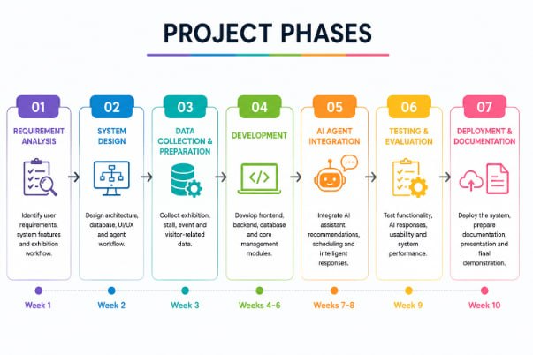
Feasibility and Project Plan

